Slide 1
Predicting music popularity on Spotify
Leo Evancie
Leo Evancie, 2021

Slide 2

The Problem
Spotify calculates popularity for each track based on engagement
How to predict popularity for new music?
Implications for content optimization and choosing new music to promote on the platform
Leo Evancie, 2021

Slide 3
The Approach
Collect and wrangle data from Spotify API
1
Explore data for trends and prepare for machine learning
2
Train a model to predict popularity of new music
3
Leo Evancie, 2021

Slide 4






1. Data wrangling
Leo Evancie, 2021

Slide 5
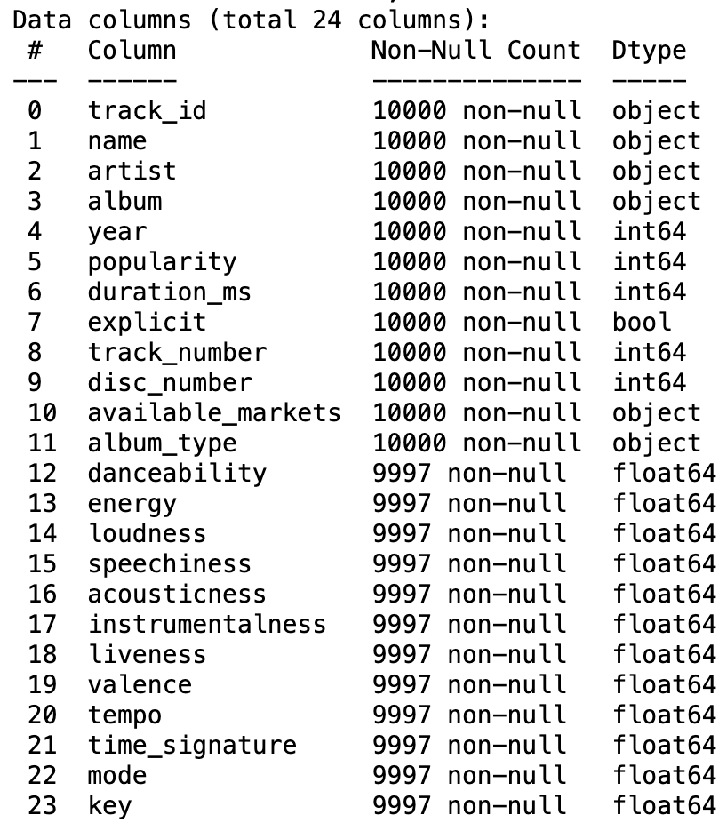
Dataset
Spotipy library, built to engage with Spotify API
“Search” endpoint
track_id, name…
“Tracks” endpoint
danceability, energy…
Leo Evancie, 2021

Slide 6

2. Exploratory data analysis
Leo Evancie, 2021

Slide 7
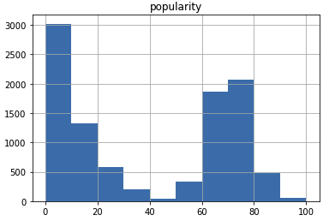
Target inspection
Popularity listed as 0 to 100
Bimodal distribution
Binary classification; greater than or equal to 50 -> “popular”
Leo Evancie, 2021

Slide 8
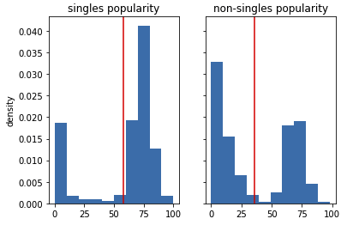
Feature inspection
Lower track numbers more popular
Singles more popular than tracks from album
Higher danceability more popular
Medium energy popular; very low or high energy less so
Modest cluster of high instrumentalness with low popularity
86% of explicit tracks popular
89% of tracks with guest artist popular
Duration important to popularity, peaking around 200 seconds
Standard time signature popular
Leo Evancie, 2021

Slide 9

3. Predictive modeling
Leo Evancie, 2021

Slide 10
Model candidates
ensembles
Logistic regression
K-nearest neighbors
Random forest classifier
Gradient boosting classifier
Leo Evancie, 2021

Slide 11
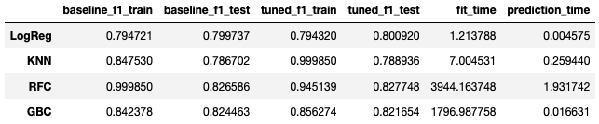




Model comparison
Leo Evancie, 2021

Slide 12

Conclusions and next steps
Leo Evancie, 2021

Slide 13
Gradient boosting classifier showed high f1, low overfit, and fast prediction times
Tease apart the role of genre
API constraints led to decisions about how to collect tracks; a different search approach could yield similar-sized dataset comprised of all newer music
Potential for further feature engineering and parameter tuning
Leo Evancie, 2021

